Slide 1
Business Data Transformations – Homework 3
Dr. Pawel Kalczynski

Slide 2
Questions to be Answered
Q3.1: Take the last full month of NYISO data (e.g. Mar. 2022 if the assignment is due in Apr. 2022) and plot the hourly (you need to average the load for each hour based on the five minute periods) load for your assigned zone with Excel or dygraphs for the entire month (24*days) - use appropriate axes’ labels
Q3.2: Using the data from Q3.1, create a 24 hours-ahead load forecast and show the forecast plot generated in R (with prediction intervals) – you may use the standard “ancient” R plot for this one
Q3.3: Calculate the MAPE of your forecast using historical data for the first day (24 hours) of the month following the month you used to fit the model (e.g. Apr. 1st if you used Mar. to fit)
Q3.4: Use Excel or dygraphs to show the historical and predicted load for the first day of the month following the month you used to fit the model (just the 24 hours)
Hint: Complete Parts 4a and 4b before starting this homework. You will need a working electricitymarket database in PostgreSQL and my electricity_market.r code to complete this homework.

Slide 3
Zone Assignment
(# of visible characters in your first name + # of visible characters in your last name) modulus 11 is the zone number
For example, Pawel Kalczynski: (5+10) mod 11 = 4
(nchar('Pawel')+nchar('Kalczynski')) %% 11
So, I would be working on HUD VL
Note: For the number of characters use your name exactly as it is stored in Canvas. For example:
Jane Mary Doe-Smith (4+4+9)
Dash is counted as a character, blank is not
0. CAPITL
1. CENTRL
2 . DUNWOD
3. GENESE
4. HUD VL
5. LONGIL
6. MHK VL
7. MILLWD
8. N.Y.C.
9. NORTH
10. WEST

Slide 4
Requirements
Submit a single PDF file (not a zipped folder!) with answers to each question and the SQL or R code (also for any views) in a textbox. See the template on the next slide.
Note: If you did not use SQL or R code, explain in the textbox which tools you used to get the result.

Slide 5
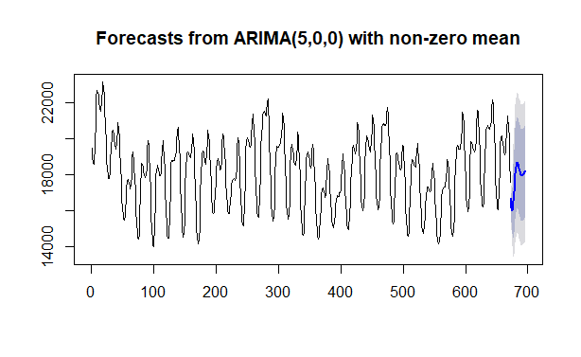
Template
[First Name] [Last Name]
Selected Zone: ####
Q3.2
Acceptable output will look similar to:
Q3.3: Calculate the MAPE if your forecast using historical data for the first day (24 hours) of the month following the month you used to fit the model
The expected output is:
MAPE= #.###
accuracy$### <- ###
…
mape<-mean(accuracy$APE)

